Slide 1
5.2 Project Auditing

Slide 2
The Project Audit
What and why
Benefits of a project audit
Judging success and failure
Determining project objectives
Contents and format of a project audit
Project Audit Life Cycle
Responsibilities of an auditor

Slide 3
What is a Project Audit, & Why Is It Done?
A formal inquiry into any or all aspects of a project
It is highly flexible and may focus on whatever matters senior management desires
Must have credibility in the eyes of the stakeholders
Possible reasons:
Revalidate the business feasibility of the project
Reassure top management
Confirm readiness to move to next phase of project
Investigate specific problems
Notes:
The term evaluate means to set the value of or appraise

Slide 4
Some Specific Benefits of a Well-Done Project Audit
Identify problems earlier
Clarify performance/cost/schedule relationships
Improve project performance
Identify future opportunities
Evaluate performance of project team
Reduce costs
Inform client of project status/prospects
Reconfirm feasibility of/commitment to project

Slide 5
Judging a Project’s Success
To what extent is a project meeting its objectives?
Efficiency: Does the project use resources in a cost-effective manner? Cost efficiency? Schedule efficiency?
Customer impact/satisfaction: Quality, timeliness, customer satisfaction, meeting/exceeding specifications.
Business success: Meeting expectations in ROI, market share, cash flow
Future potential: Will project lead to future business prospects?

Slide 6
The Difference Between Project Success & Failure
Audits of 110 projects over 11 years reveal four basic differences between success and failure
Objectivity in design, scope, cost and schedule
Experienced people throughout project
Authority commensurate with responsibility
Clear responsibility and accountability

Slide 7
Determining What the Project Objectives Really Are
Explicit objectives are easy to find
Cost, schedule, performance specs
Profit targets
Ancillary objectives are not
Examples include lessons learned i.e. retaining employees, maintaining a customer, getting a “foot in the door,” developing a new capability, blocking a rival

Slide 8
Determining What the Project Objectives Really Are
Ancillary goals
Identify organizational strengths and weaknesses in project-related personnel, management, and decision-making techniques and systems
Identify risk factors in the firm’s use of projects
Improve the way projects contribute to the professional growth of project team members
Identify project personnel who have high potential for managerial leadership

Slide 9
Ancillary Objectives are Important, but Often Obscure
If an audit ignores ancillary objectives, it will draw an incomplete picture
But people tend to disguise ancillary objectives. Why?
If not explicit, how can it be judged a failure?
People and teams may have their own goals and priorities
The stronger the project culture, the greater the suspicion toward outsiders, e.g., auditors

Slide 10
Costs of Project Audits
While audits offer benefits, they aren’t free
Some costs are obvious, others less so
Salaries of auditors and staff
Distraction from project work
Before and during the audit
Anxiety and morale within the project
Cost of outside experts

Slide 11
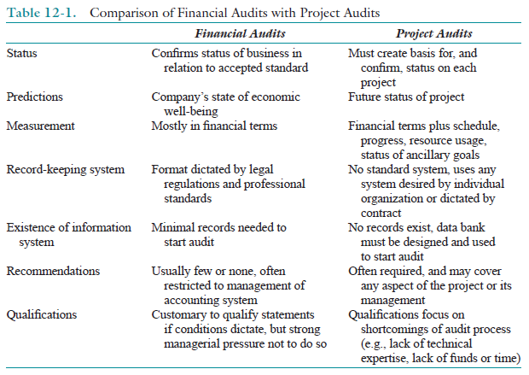

Slide 12
Timing of the Audit
Early audits tend to focus on technical issues, and tend to benefit the project
Later audits lean toward cost and schedule, and tend to benefit the parent organization
Transfer of lessons learned to other projects

Slide 13
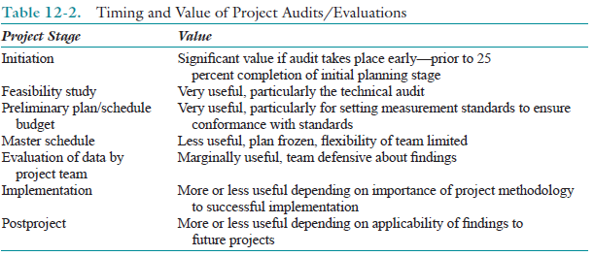

Slide 14
Contents of a Project Audit
Format can vary, but six areas should be covered (Project status, in all dimensions):
Current status of the project
Future status
Status of crucial tasks
Risk assessment
Information pertinent to other projects
Limitations of the audit
Far broader in scope than a financial audit.
May deal with the project as a whole or any component or set of components of the project
Notes:
1. Current status of the project. Does the work actually completed match the planned level of completion?
2. Future status. Are signifi cant schedule changes likely? If so, indicate the nature of the changes.
3. Status of crucial tasks. What progress has been made on tasks that could decide the success or failure of the project?
4. Risk assessment. What is the potential for project failure or monetary loss?
5. Information pertinent to other projects. What lessons learned from the project being audited
can be applied to other projects being undertaken by the organization?
6. Limitations of the audit. What assumptions or limitations affect the data in the audit? These six parts of the audit report will be discussed in more detail in the next section of this chapter.

Slide 15
The Audit/Evaluation Team
Typical areas that may furnish audit team members are:
The project itself
The accounting/controlling department
Technical specialty areas
The customer
The marketing department
Purchasing/asset management
Human resources
Legal/contract administration department
Chapter 12-22

Slide 16
A Format for a Project Audit
Introduction
Including project objectives
Also audit assumptions, limitations
Current project status
Cost
Schedule
Progress/Earned Value
Quality

Slide 17
Format for Project Audit (cont’d)
Future Project Status
Conclusions and recommendations
Critical Management Issues
A Pareto approach
Risk Management
Major threats to project success
Appendices

Slide 18
The Project Audit Life-Cycle
Like the project itself, the audit has a life cycle
Six basic phases:
1. Project audit initiation
Focus and scope of audit; assess methodologies, team members required
2. Baseline Definition
Determine the standards against which performance will be measured

Slide 19
The Audit Life Cycle (cont’d)
3. Establishment of Audit Database
Gathering/organizing pertinent data
Focus on what’s necessary
4. Data Analysis
The judgment phase
Comparison of actuals to standard

Slide 20
The Audit Life Cycle (cont’d)
5. Audit Report Preparation
Present findings to PM first
Then, prepare final report
6. Audit Termination
Review of audit process
Disbanding of team

Slide 21
Responsibilities of a Project Auditor
As in medicine, “first do no harm”
Be truthful, upfront with all parties
Maintain objectivity and independence
Acknowledge entering biases
Project confidentiality
Limit contacts to those approved by management

Slide 22
5.3 Project Procurement management
Project Procurement Management includes the processes necessary to purchase or acquire products, services, or results needed from outside the project team.
Project Procurement Management includes the management and control processes required to develop and administer agreements such as contracts, purchase orders, memoranda of agreements (MOAs), or internal service level agreements (SLAs).

Slide 23
The advantages of outsourcing project work
Cost reduction. Companies can secure competitive prices for contracted services, especially if the work can be outsourced offshore. Furthermore, overhead costs are dramatically cut since the company no longer has to internally maintain the contracted services
Faster project completion. Not only can work be done more cheaply, but it can also be done faster. Competitive pricing means more resources for the rupee.
High level of expertise. A high level of expertise and technology can be brought to bear on the project. A company no longer has to keep up with technological advances. Instead, it can focus on developing its core competencies and hire firms with the know-how to work on relevant segments of the project.
Flexibility. Organizations are no longer constrained by their own resources but can pursue a wide range of projects by combining their resources with talents of other companies. Small companies can instantly go global by working with foreign partners.

Slide 24
The disadvantages of outsourcing project work
Coordination breakdowns. Coordination of professionals from different organizations can be challenging, especially if the project work requires close collaboration and mutual adjustment. Breakdowns are exacerbated by physical separation with people working in different buildings, different cities, if not different countries.
Loss of control. There is potential loss of control over the project. The core team depends on other organizations that they have no direct authority over. While long-term survival of participating organizations depends on performance, a project may falter when one partner fails to deliver.
Conflict. Projects are more prone to interpersonal conflict since the different participants do not share the same values, priorities, and culture. Trust, which is essential to project success, can be difficult to forge when interactions are limited and people come from different organizations.
Security issues. Depending on the nature of the project, trade and business secrets may be revealed. This can be problematic if the contractor also works for your competitor. Confidentiality is another concern and companies have to be very careful when outsourcing processes like payroll, medical transcriptions, and insurance information.

Slide 25
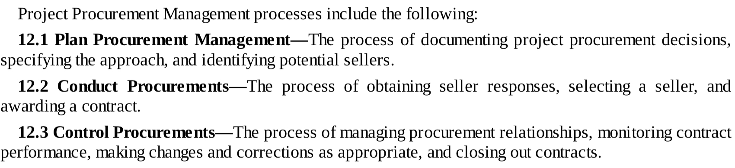
The procurement process

Slide 26
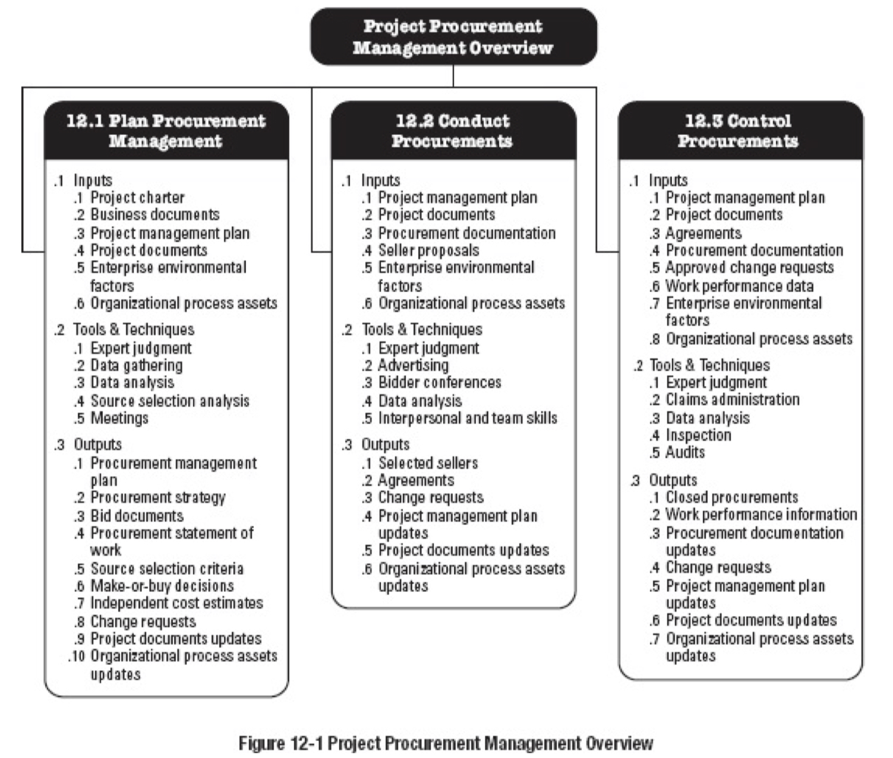

Slide 27
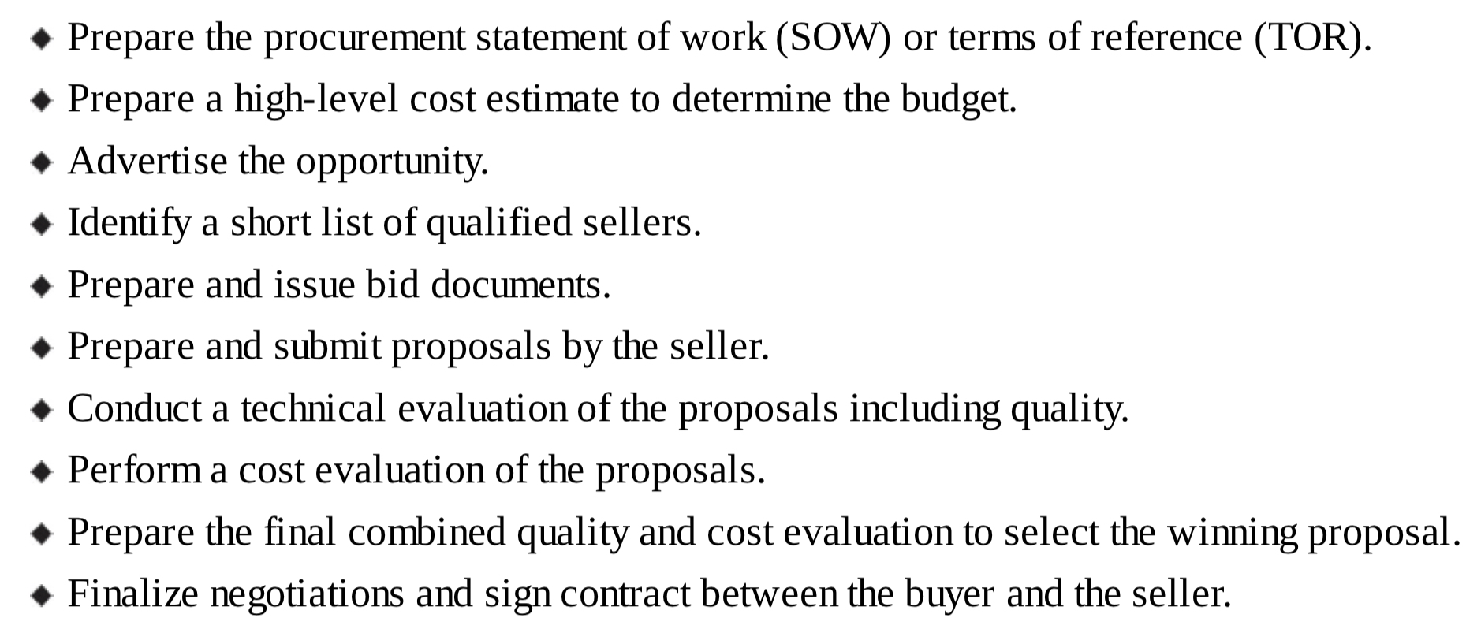
Steps in procurement planning

Slide 28
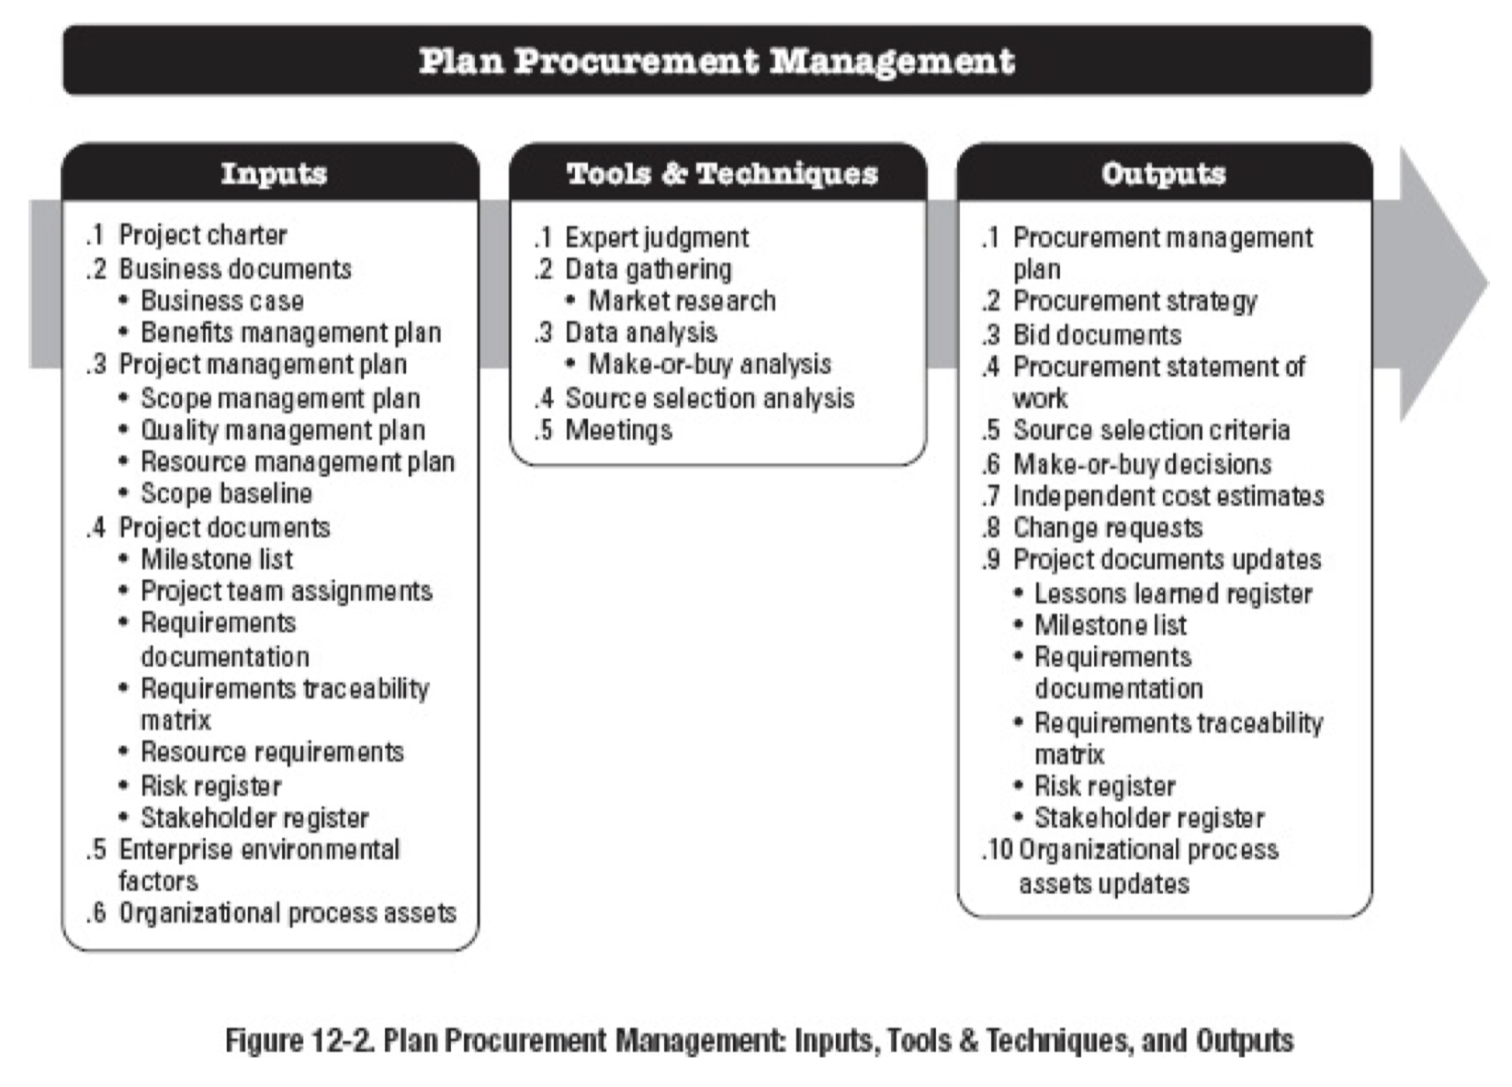

Slide 29
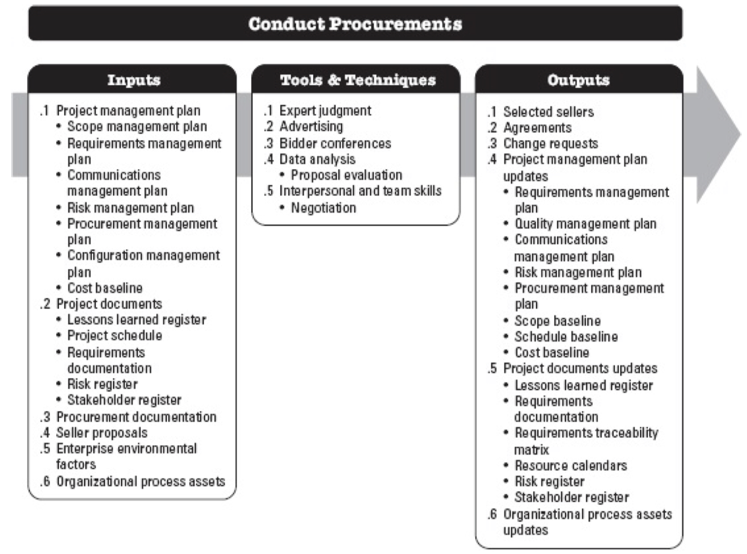

Slide 30
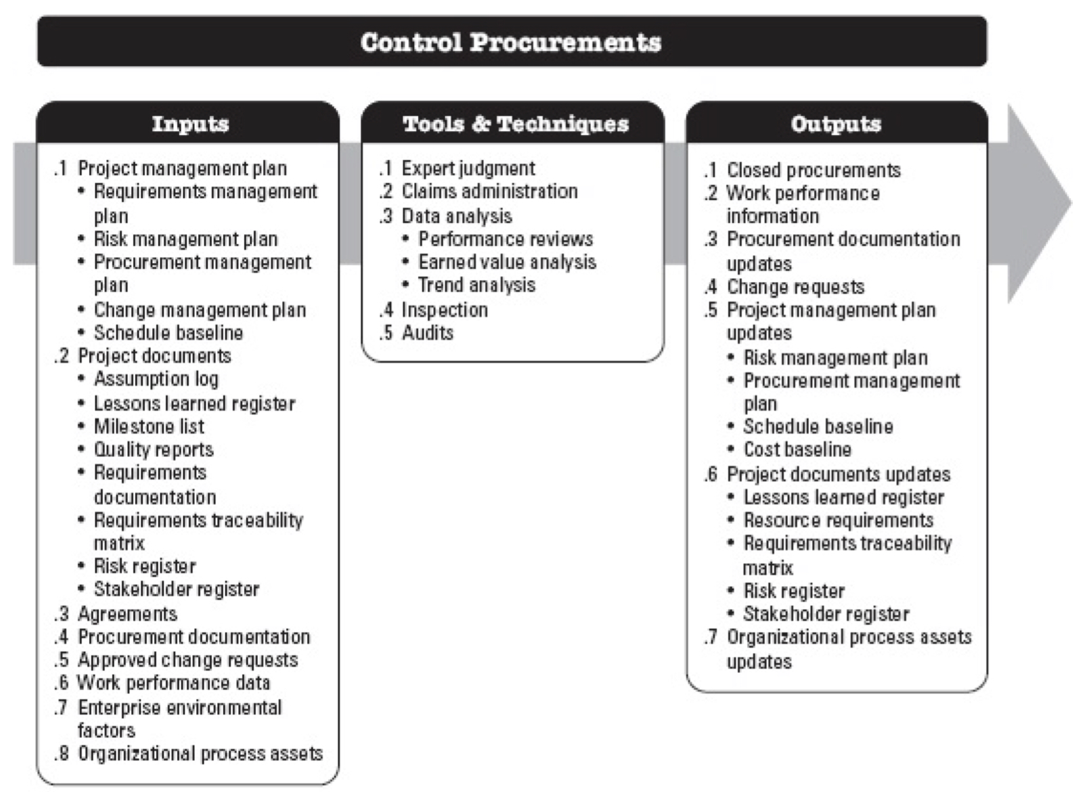

Slide 31
Summary
Outsourcing has become an integral part of project management.
More and more companies are collaborating with each other on projects to compete in today’s business world.
A number of proactive best practices have emerged among firms that have mastered the outsourcing process which include establishing well-defined requirements and procedures and utilizing fair and incentive-laden contracts.

